Slide 1

Customer Shopping Behavior Analysis
An End-to-End Full Stack Data Analytics Project leveraging Python, MySQL, and Power BI to optimize retail strategy.
DATA ANALYTICS PORTFOLIO 2026

Slide 2






EXECUTIVE PROJECT OVERVIEW
Scale & Volume
Primary Objective
Core Metrics
Analysis of 3,900 unique customer transactions across 18 descriptive features.
Uncover spending patterns and demographic preferences to drive growth.
LTV analysis, Subscription conversion, and Segment-specific revenue targets.

Slide 3

FULL-STACK DATA ARCHITECTURE
Python (ETL)
MySQL (BI)
Power BI (UI)
Cleaning, Handling Missing Values, and Feature Engineering using Pandas.
Complex queries for Customer Segmentation and Category-wise performance.
Real-time interactive dashboarding for C-suite strategic visualization.

Slide 4

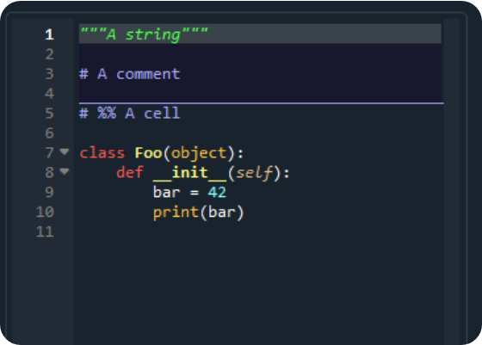
PHASE 1: PYTHON PREPROCESSING
Missing Data: Imputed Review Ratings using Category Medians.
Standardization: Applied snake_case naming for robust database integration.
Binning: Created custom age groups for nuanced demographic analysis.

Slide 5


PHASE 2: SQL BUSINESS LOGIC
Strategic MySQL Queries
Designed structured queries to answer critical profitability questions:
•
Revenue contribution by Gender and Age.
•
High-spending Discount behaviors.
•
Top Products by Rating & Categories.
•
Subscription vs Non-Subscription Spend.

Slide 6

REVENUE DISTRIBUTION ANALYSIS
Male Customers
Female Customers
Key Insight
Male customers generate ~68% of total revenue. Strategic marketing should focus on increasing the female customer Average Order Value (AOV) to balance the portfolio.

Slide 7

BEHAVIORAL SEGMENTATION
Customer Maturity Mix
Loyal Segment: 57% - High Retention Rate.
2,241
Returning Segment: 18% - Growth Potential.
New Segment: 25% - Acquisition Focus.
Loyal Customers (>10 Purchases)
Strategy: Transition 'Returning' customers to 'Loyal' through targeted loyalty rewards.

Slide 8


THE SUBSCRIPTION PARADOX
Non-Subscribers
Subscribers
$59.87
$59.49
Avg. Purchase Amount
Avg. Purchase Amount
$170,436 Total Revenue
$62,645 Total Revenue
Despite higher total volume from non-subscribers, the subscription model provides predictable cash flow and higher frequency.

Slide 9
PRODUCT & CATEGORY LEADERS
Top 5 Rated Products | Avg. Rating | Status
Gloves | 3.86 | Premium Tier
Sandals | 3.84 | Summer Favorite
Boots | 3.82 | High Durability
Hat | 3.80 | Steady Performer
Skirt | 3.79 | Steady Performer

Slide 10
REVENUE BY LIFE STAGE
Young Adult
Middle-Aged
Adult
Senior
Observation: Spending is relatively stable across age groups, indicating a broadly appealing product catalog.

Slide 11
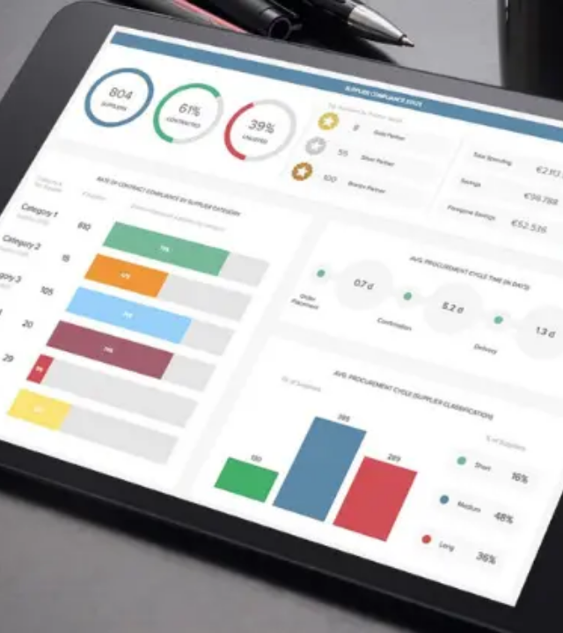
POWER BI INTERACTIVE UI
Real-time Decision Support
Integrated filters for subscription, gender, and category to allow business leaders to slice data instantly.
•
Dynamic KPI cards for AOV and Ratings.
•
Geographic and Seasonal heatmaps.
•
Segment-level drill-down capabilities.

Slide 12


STRATEGIC ROADMAP
Growth Levers
Quick Wins
🚀 Loyalty Transition: Reward 'Returning' users with express shipping to convert to 'Loyal'.
✅ Exclusive early-access sales for current subscribers.
💸 Margin Control: Reduce discount dependency on high-rated products (e.g., Gloves).
✅ Bundled offers for low-frequency categories.
✅ Personalized email marketing based on previous category preference.
🎯 Targeted Ads: Focus high-CAC campaigns on the high-revenue Young Adult segment.

Slide 13
Thank You!
Full Stack Data Analytics Portfolio Project
QUESTIONS & ANSWERS
github.com/vineet416 linkedin.com/in/analytics-pro

Slide 14



IMAGE SOURCES
https://user-images.githubusercontent.com/17051931/48866619-0c7b8180-ed99-11e8-960b-95cb2d5c43e2.png
Source: github.com
https://static.vecteezy.com/system/resources/previews/052/771/156/non_2x/glowing-neon-database-icon-illustrating-data-storage-concept-vector.jpg
Source: www.vecteezy.com
https://www.rib-software.com/app/uploads/2024/06/dashboard-design-principles-blog-rib.webp
Source: www.rib-software.com

